Slide 1

Natural Language Computing
Natural Language Computing:
A Necessity for Cognitive Computing and Intelligent Internet
PLENARY TALK
17th International Conference on
ARTIFICIAL INTELLIGENCE, KNOWLEDGE ENGINEERING and DATA BASES (AIKED '17), Feb 25, 2017, Cambridge University, U.K.
Emdad Khan
Dept. of CS
Maharishi U. of Management (MUM)
Iowa, USA, ekhan@mum.edu
Natural Language Computing

Slide 2
Natural Language Usage Growing Fast!
People prefer to talk and type (Talking is preferred usually). NL Applications are growing fast!
Natural Language is the best natural user Interface with any computing device; and almost essential with very small devices like IOT using Voice.
  In fact, Natural Language is becoming a necessity for next generation Internet (Intelligent Internet) –
      that supports key features like requesting a specific information (e.g. show me the pictures of last Saturday party), or getting specific answer to a question and the like.
Natural Language Computing
Notes:
Suggest go back to Internet centric. You do not have enough in this presentation to position the company as a gadget interface
Pls use another slide master. The current background is very distracting.

Slide 3
Dealing With Information
Today, Correctly Dealing with the Information/ Data is the Name of the Game!
In this Data Driven World, we have Both Structured & Unstructured Data.
Structured data is basically numbers at its core:
  How many times a page was visited,
  The Click Through Rate (CTR)
Analysis based on Counting.
Huge benefits to Businesses & Other Organization.
Natural Language Computing
Notes:
Suggest go back to Internet centric. You do not have enough in this presentation to position the company as a gadget interface
Pls use another slide master. The current background is very distracting.

Slide 4
Unstructured Data Dominates!
Structured data represent about 20% of total data
Unstructured data (80%: Text, audio, video, image) dominates & hence More Important (no Known Structure).
It is a Necessity to address Unstructured data Problems.
Counting and number based approach does NOT work anymore for Unstructured data (next slide).
Natural Language Computing (NLC) is Now a Necessity.
Natural Language Computing
Notes:
Suggest go back to Internet centric. You do not have enough in this presentation to position the company as a gadget interface
Pls use another slide master. The current background is very distracting.

Slide 5
Unstructured Data: Counting Does Not Work
What type of count or interpretation can be made
  From customer feedbacks in a running text
  From a voice recording of a customer service transaction?
  How are tweets be interpreted and analyzed?
  What type of information can be gleaned from customer product reviews?
  What happens when customer reviews are videos?
Natural Language Computing
Notes:
Suggest go back to Internet centric. You do not have enough in this presentation to position the company as a gadget interface
Pls use another slide master. The current background is very distracting.

Slide 6
Addressing Unstructured Data
Clearly, we need to address Unstructured Data
  We also need to address mixed (Structured & Unstructured) Data
  Hence need to Integrate both in an appropriate way
  Some companies already started doing so, especially using Text Mining using Existing NLP Tools.
  Such Tools use Common NLP Algorithms: Sentence Segmentation, Tokenization, Stemming, POS (Part of Speech Tagging), NER (Name Entity Recognition), Parsing and some basic semantics, and some good context (e.g. Word2vec).
Natural Language Computing
Notes:
Suggest go back to Internet centric. You do not have enough in this presentation to position the company as a gadget interface
Pls use another slide master. The current background is very distracting.

Slide 7
Much More Complex Approach Needed for Unstructured Data
Much more complex problems to solve to handle Big Data and Data Science needs dominated by unstructured data.
  The key is to use NLP based computing (NLC – Computing Using Semantics) with a highly capable and efficient Semantic Engine.
  Existing Semantics using Predicate logic, Ontology and the like have issues – need to define semantics for almost everything!
  Other key areas are
      AI, Machine Learning Related advanced algorithms
      Natural Language based UI (User Interface)
      Effective and efficient integration of all these – a complex multidisciplinary Area
Natural Language Computing
Notes:
Suggest go back to Internet centric. You do not have enough in this presentation to position the company as a gadget interface
Pls use another slide master. The current background is very distracting.

Slide 8
Example with Existing
Methods for Semantics
“Maharani serves vegetarian food.”
Semantics represented by existing methods, e.g. Predicate Logic, is
  Serves(Maharani, Vegetarian Food) and
  Restaurant(Maharani)
Now, if we ask
“is vegetarian dishes served at Maharani ?
  – System will NOT be able to answer
  [we need to define semantics for vegetarian dishes!
  >> Mechanical Semantics]
Natural Language Computing
Notes:
Suggest go back to Internet centric. You do not have enough in this presentation to position the company as a gadget interface
Pls use another slide master. The current background is very distracting.

Slide 9
SEBLA and its Key Concepts
Semantic Engine Using Brain-Like Approach (SEBLA).
Considers Each Word as “Semantic Object”.
Semantics of a sentence is calculated by using the semantics of words.
Semantics of a Paragraph is calculated using the Semantics of Sentences.
Natural Semantics as opposed to Mechanical Semantics.
Natural Language Computing
Notes:
Suggest go back to Internet centric. You do not have enough in this presentation to position the company as a gadget interface
Pls use another slide master. The current background is very distracting.

Slide 10
SEBLA – Semantics Details
Algorithm to Calculate Semantics:
    Sentence Level
We consider each parsed word in the refined sentence. For each of such word,
  Get the Function words
  Get the World Knowledge (WK) words
E.g. for the word “ball”, the function words are {ball, move, roll, round, play..}
Function Words defines the semantics or meaning of a word
Natural Language Computing
Notes:
Suggest go back to Internet centric. You do not have enough in this presentation to position the company as a gadget interface
Pls use another slide master. The current background is very distracting.

Slide 11
SEBLA – Semantics Details
Words | Function Words | Function Words with highest membership function value (> 0.9)
ball | Move, roll, round, bounce back, play | roll, round, bounce back, play
eat | Chewing, drinking, putting things in mouth, biting, swallowing,… | putting things in mouth, biting, swallowing
happy | Feeling good, not depressed, excited, | Feeling good, excited
shop | Buy, sell, convenience store, | Buy, sell
Fig. 3: Sample Table for (a) Sample Function Words,
Natural Language Computing
Notes:
Suggest go back to Internet centric. You do not have enough in this presentation to position the company as a gadget interface
Pls use another slide master. The current background is very distracting.

Slide 12
Features of a Fully Capable NLU System
A Full NLU System Would:
Paraphrase an input text.
Translate the text into another language.
Answer questions about the contents of the text.
Draw inferences from the text.
SEBLA Does These Well -
Existing NLU methods cannot do all these mainly because of the lack of a “Natural Semantic Engine”.
Natural Language Computing
Notes:
Suggest go back to Internet centric. You do not have enough in this presentation to position the company as a gadget interface
Pls use another slide master. The current background is very distracting.

Slide 13
Advanced Analytics
Internet or other source of Information
Interface for Internet or other source of Information
(structured & unstructured)
Integrating Structured,
Unstructured & Mixed Data
Analysis using SEBLA, NLP,
AI, Data Mining, Statistics and
ML with Deep Learning
Machine Learning Based
Continuous Refinement
Intelligent Information
Retrieval & Getting
Requested Information
User Interface
Question Answering,
Summarization & Drawing
Inference
Input Query or Request / Desired Output
Fig. 1 Advanced Analytics: Uses Semantic Engine Using Brain-Like Approach (SEBLA), AI, ML, Data Mining, Statistics and other fields. Intelligent Agent allows NLP based UI and supports all key features including Information Retrieval, Question Answering, Summarization and Drawing Inference.
Natural Language Computing
Notes:
Suggest go back to Internet centric. You do not have enough in this presentation to position the company as a gadget interface
Pls use another slide master. The current background is very distracting.

Slide 14
The Progression of the Internet
Internet Sort of Started with Portal (like Yahoo)
Then Moved to Search (e.g. Yahoo, MSN, Google)
Then Moved to Transaction (eBay, Amazon)
Then to Social Networks (Facebook, Twitter)
What’s Next?
Natural Language Computing
Notes:
Suggest go back to Internet centric. You do not have enough in this presentation to position the company as a gadget interface
Pls use another slide master. The current background is very distracting.

Slide 15
What’s Next?
We See a Clear Trend that the future Internet is going to be something that can provide
Very Specific
More Precise and Direct Information
In a Very Easy Way so that
Anyone including an Illiterate Person can Access and Use it at Ease
Natural Language Computing
Notes:
Suggest go back to Internet centric. You do not have enough in this presentation to position the company as a gadget interface
Pls use another slide master. The current background is very distracting.

Slide 16
Intelligent Internet
Show me all the pictures from last Saturday party.
I would like to buy the following book - Artificial Intelligence by Stuart Russel, 3rd edition; use my credit card on file and ship it to my home address.
How can I sell my wheat or rice online? Or how I can I improve my rice / wheat production?
How many students graduated from Stanford University in Computer Science in 2016?
What can we infer from the key news about company xyz during last 3 months?
Natural Language Computing
Notes:
Suggest go back to Internet centric. You do not have enough in this presentation to position the company as a gadget interface
Pls use another slide master. The current background is very distracting.

Slide 17
Intelligent Internet (IINT): Architecture
Internet
W2
W3
Keys
IA
NLC
Big Data
Main Agent
(IA)
Sub Agent 1
Sub Agent 2
Agents of a Website, W1
Figure 2: Intelligent Internet (IINT) - showing a website with a main Intelligent Agent (IA) and 2 sub Agents. Sub Agents can perform functions like transactions or e-Learning etc. Such a website can have a Super Intelligent Agent (SIA) to handle more difficult tasks by collaborating with other websites. The Agents may reside on a different website(s).
Natural Language Computing
Notes:
Suggest go back to Internet centric. You do not have enough in this presentation to position the company as a gadget interface
Pls use another slide master. The current background is very distracting.

Slide 18
Some Applications - Search
Today’s Search
Uses String Match (# of words, IDF,….) – Millions of hits!
Example - "Auto body shops in San Francisco bay area", Google gave the following:
  " About 1,200,000 results (0,45 seconds) ".
There are probably not 1.2M Auto body shops in the whole world! There are Key Issues!
Natural Language Computing
Notes:
Suggest go back to Internet centric. You do not have enough in this presentation to position the company as a gadget interface
Pls use another slide master. The current background is very distracting.

Slide 19
Intelligent Search
Intelligent Search Means Search That:
Uses Semantics and Deep Semantics (not just string matching) of NLP
Uses Meaning of Words to derive the Meaning of the (a) Input String / Sentence and (b) Title of the Results
Uses Semantic Matching of the Titles with Input Sentence to Derive Results
Demo Using SEBLA (Semantic Engine Using Brain-Like Approach) “Low Price Thai Restaurant Silicon Valley”
Natural Language Computing
Notes:
Suggest go back to Internet centric. You do not have enough in this presentation to position the company as a gadget interface
Pls use another slide master. The current background is very distracting.

Slide 20
Intelligent Search
Internet or other source of Information
Interface for Internet or other source of Information: Retrieving Search Results (or expanded search results based on more appropriate Search List) using an Existing Search Engine
Rendering Using
SEBLA and / or Other Methods
And Assembling the Most
Desired Content
Compare Semantics of input sentence with Semantics of Result Titles. Select Best Matched Results
Language Translation
Monitoring and Evaluation
User Interface
Machine Learning Based
Continuous Refinement
Input Query Sentence / Desired Output
Fig. 3 Semantic Engine Using Brain-Like Algorithm – showing complete retrieval of desired information. The Intelligent Agent (IA) shown is for Intelligent Search using SEBLA, SEBLA_IS.
Natural Language Computing
Notes:
Suggest go back to Internet centric. You do not have enough in this presentation to position the company as a gadget interface
Pls use another slide master. The current background is very distracting.

Slide 21
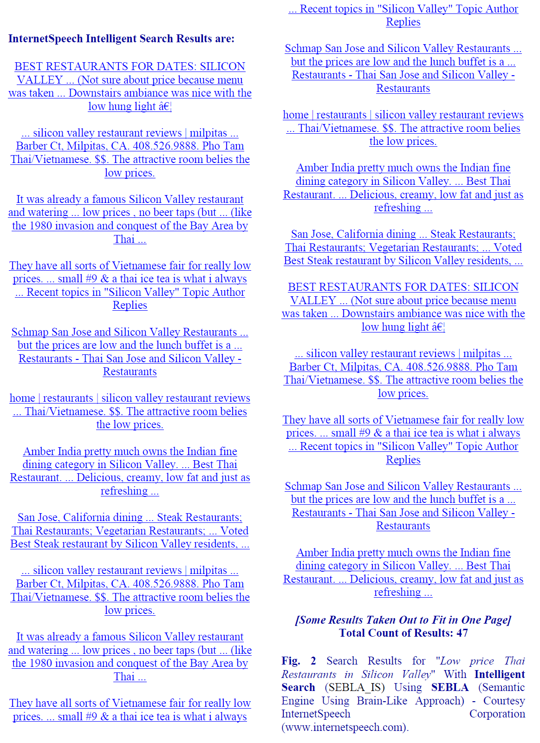
DEMO on Intelligent Search
Natural Language Computing
Notes:
Suggest go back to Internet centric. You do not have enough in this presentation to position the company as a gadget interface
Pls use another slide master. The current background is very distracting.

Slide 22
Existing Machine Learning (ML) Algorithms
Existing ML algorithms mainly address the learning of numerical data. Great success in many applications!
Such algorithms mainly do Classification, Regression and Clustering.
Common numerical features (e.g. diameter, weight or shape for coin recognition; or eyes, nose, mouth, eyebrows for face recognition) are used.
Generalization is inadequate, especially when using complex data, large data or text data.
Natural Language Computing
Notes:
Suggest go back to Internet centric. You do not have enough in this presentation to position the company as a gadget interface
Pls use another slide master. The current background is very distracting.

Slide 23
ML Algorithms for Unstructured Data
Learning meaning of words, sentences, paragraphs is the key for many natural language applications (Text data).
Existing ML algorithms (numerical data - Classification, Regression and Clustering) are not adequate for such semantics driven applications.
Existing methods to define / learn semantics e.g. Predicate Logic / Ontology “mechanical semantics” and can’t handle complex tasks.
New ML algorithms are needed for text driven data.
Natural Language Computing
Notes:
Suggest go back to Internet centric. You do not have enough in this presentation to position the company as a gadget interface
Pls use another slide master. The current background is very distracting.

Slide 24
MACHINE LEARNING PARADIGM FOR UNSTRUCTURED DATA - 1
NEW PARADIGM IS NEEDED – NEED TO LEARN SEMANTICS
Machine learning algorithms for natural language semantics (MLANLP) we developed uses a NEW PARADIGM
Semantics of Words calculate Semantics of Sentences; Semantics of sentences calculate semantics of paragraphs; Semantics of paragraphs calculate the semantics of a document.
Proper Actions need to be learned / computed addition to semantics
Natural Language Computing
Notes:
Suggest go back to Internet centric. You do not have enough in this presentation to position the company as a gadget interface
Pls use another slide master. The current background is very distracting.

Slide 25
MACHINE LEARNING PARADIGM FOR UNSTRUCTURED DATA - 2
Logic is needed to learn Actions
Semantics & logic driven learning paradigm mainly uses good explanation / logic rather than training using a large dataset (similar to the way human learns)
We learn when someone explains or teaches (uses small number of examples)
Semantics driven learning process uses computing and learning at the same time for many cases
New Paradigm needs to Derive new Semantics & Knowledge
Natural Language Computing
Notes:
Suggest go back to Internet centric. You do not have enough in this presentation to position the company as a gadget interface
Pls use another slide master. The current background is very distracting.

Slide 26
MLANLP Example
“Show me the pictures of last Saturday birthday party from my Facebook account” [Use Semantics & Logic to compute Actions]
Computed ACTIONS:
Go to the Facebook & log on
Calculate the date for last Saturday using today’s date. Search Birthday party pictures & get relevant pictures.
Present the requested pictures in a nice presentable form to the user.
Natural Language Computing
Notes:
Suggest go back to Internet centric. You do not have enough in this presentation to position the company as a gadget interface
Pls use another slide master. The current background is very distracting.

Slide 27
DERIVING NEW SEMANTICS & KNOWLEDGE: CC - 1
Consider the following 3 sentences:
I was tired. I fell asleep. Did work and made some good progress after I woke up.
Need to find causal relationships by using the semantics between sentences.
The semantics of “tired” and “asleep” are related. Then from WK, we know that “tired” caused / may cause “asleep”. Thus, the causal relationship between first 2 sentences are established.
Natural Language Computing
Notes:
Suggest go back to Internet centric. You do not have enough in this presentation to position the company as a gadget interface
Pls use another slide master. The current background is very distracting.

Slide 28
DERIVING NEW SEMANTICS & KNOWLEDGE: CC - 2
In the 3rd sentence “After I woke up” is opposite of “asleep” and hence a relation is established.
And “made some good progress” is related with not “tired” in the first sentence.
The basic information in WK will help compute the causal relationship between first sentence and 3rd sentence. Thus, MLANLP will Compute the NEW Derived fact:
“I made good progress” because my “tiredness” was gone due to “sleep”.
Natural Language Computing
Notes:
Suggest go back to Internet centric. You do not have enough in this presentation to position the company as a gadget interface
Pls use another slide master. The current background is very distracting.

Slide 29
Helping Global Development
NLP based computing will help many more people to enjoy the benefits of the Internet & Information Age in a much more effective and efficient way;
Enabling many more people around the world, especially, in the underdeveloped and developing countries to effectively bridge the Digital and Language Divides in a practical way.
Help sustainable global development by focusing on Education, Innovation and Entrepreneurship.
Natural Language Computing
Notes:
Suggest go back to Internet centric. You do not have enough in this presentation to position the company as a gadget interface
Pls use another slide master. The current background is very distracting.

Slide 30
Title: Natural Language Based Intelligent Robot to Advance Industrial Automation and Digital Manufacturing:
Plenary Talk: Prof. Emdad Khan
6th World Convention on
Robots, Autonomous Vehicles and Deep Learning
September 10-11, 2018 Singapore
Natural Language Computing
Notes:
Suggest go back to Internet centric. You do not have enough in this presentation to position the company as a gadget interface
Pls use another slide master. The current background is very distracting.

Slide 31

Lifelong Machine Learning Using Logic, Semantics and NLP
LIFELONG MACHINE LEARNING -
Help Achieving Human Like Intelligence
USING LOGIC, SEMANTICS &
NATURAL LANGUAGE PROCESSING
21st International Conference on Artificial Intelligence
Dr. Emdad Khan,
Dept. of CS, Maharishi U. of Management (MUM), Fairfield, Iowa, USA
InternetSpeech, Inc, San Jose, California, USA
ekhan@mum.edu, emdad@internetspeech.com
Lifelong Machine Learning with Semantics, Logic & NLP

Slide 32
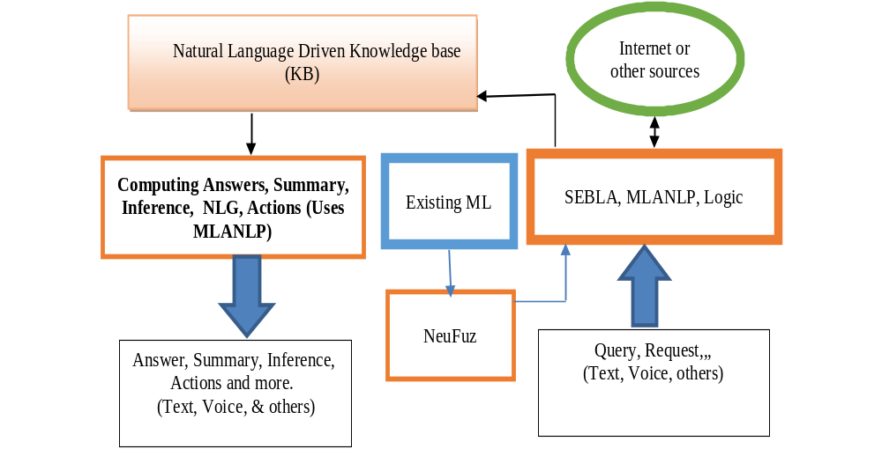
LML System using Natural Language,
Semantics & Logic (LMLS_NL_SEM_LOGIC)
Lifelong Machine Learning Using Logic, Semantics and NLP
Notes:
Suggest go back to Internet centric. You do not have enough in this presentation to position the company as a gadget interface
Pls use another slide master. The current background is very distracting.

Slide 33
References / Further Reading
[1] E. Khan, “Lifelong Machine Learning with Logic, Semantics and Natural Language Processing”, International Conference on Artificial Intelligence (ICAI 2019), July 29 -Aug 1, 2019, Las Vegas, USA.
[2] E. Khan, “Machine Learning Algorithms for Natural Language Semantics and Cognitive Computing”, The 2016 International Conference on Computational Science and Computational Intelligence (CSCI'16), Dec 15-17, 2016, Las Vegas.
[3] E. Khan, "Next generation web - intelligent search, question answering, summarization and more", INTERNATIONAL JOURNAL of COMPUTERS AND COMMUNICATIONS, (NAUN & UNIVERSITY PRESS), Vol. 9, June 2015.
[4] E. Khan, " Intelligent Internet: Natural Language and Question & Answer based Interaction”, INTERNATIONAL JOURNAL of COMPUTERS AND COMMUNICATIONS, (NAUN & UNIVERSITY PRESS) Oct. 2013.
[5] C. Eaton et al, “Understanding Big Data: Analytics for enterprise class Hadoop and Streaming Data”, http://public.dhe.ibm.com/common/ssi/ecm/en/iml14296usen/IML14296USEN.PDF
[6] Wikipedia – “Big Data” - http://en.wikipedia.org/wiki/Big_data
[7] P. Ryan et al, “The Problem of Analyzing Unstructured Data”, Grant Thoronton, 2009,
http://www.grantthornton.ie/db/Attachments/Publications/Forensic_&_inve/Grant%20Thornton%20-The%20problem%20of%20analysing%20unstructured%20data.pdf
[8] E. Khan, “Addressing Big Data Problems using Semantics and Natural Language Understanding", 12th WSEAS International Conference on
TELECOMMUNICATIONS and INFORMATICS (TELE-INFO '13) in Baltimore, MD, USA, September 17-19, 2013.
[9] E. Khan, "Processing Big Data with Natural Semantics and Natural Language Understanding using Brain-Like Approach”, INTERNATIONAL JOURNAL of COMPUTERS AND COMMUNICATIONS, (NAUN & UNIVERSITY PRESS) January 2014.
[10] E. Khan,: Natural Language Understanding Using Brain-Like Approach: Word Objects and Word Semantics Based Approaches help Sentence Level Understanding, US Patent filed on July, 2011
[10] E. Khan, "Natural Language Processing, Big Data, Bioinformatics and Biology”, INTERNATIONAL JOURNAL OF BIOLOGY AND BIOMEDICAL ENGINEERING (NAUN & UNIVERSITY PRESS), June 2014.
[11] Khan, E., (2011): Internet For Everyone: Reshaping the Global Economy by Bridging the Digital Divide” published in Aug, 2011; 978-1-4620- 4251-7 (SC ISBN)
Natural Language Computing
Notes:
Suggest go back to Internet centric. You do not have enough in this presentation to position the company as a gadget interface
Pls use another slide master. The current background is very distracting.

